Slide 1


Internship carried out by
Guillaume BIENFAIT
M1 Info @ UBx
2021-2022
Supervised by
Aurelien ESNARD & Abdou GUERMOUCHE
With technical support of
Christophe DELMON

Slide 2

Outline
Context
Architecture
Webterm
Current Status

Slide 3
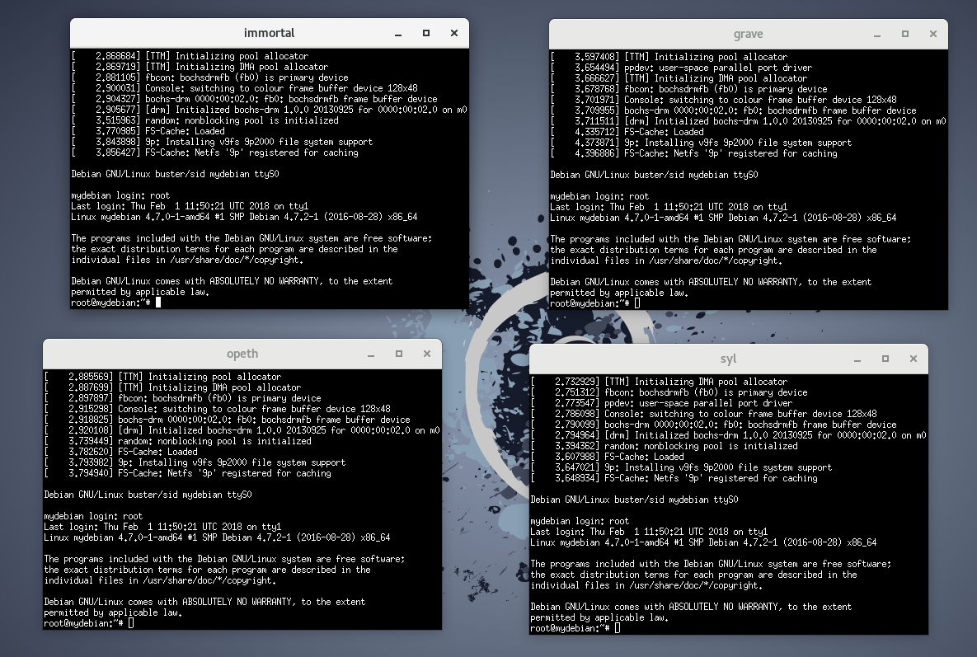
Context – QemuNet
A solution based on virtualization to learn network (routing, firewall, …)
⇒ a light shell script based on Qemu Virtual Machine and VDE Virtual Switch
(1) describe your own network topology
(2) start your virtual network (as root), break it, and start again…
# Topology: LAN
#
# opeth grave
# \ /
# [s1]
# / \
# syl immortal
SWITCH s1
HOST debian immortal s1
HOST debian opeth s1
HOST debian syl s1
HOST debian grave s1
⇒ https://github.com/orel33/qemunet
Notes:
Qemu – a generic and open source machine emulator and virtualizer

Slide 4
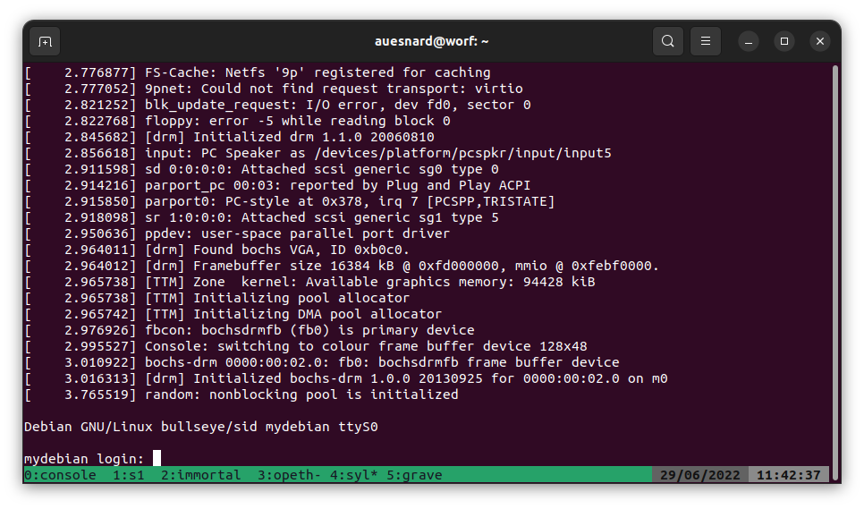
Context – How to use QemuNet at Home?
Former solution based on SSH + TMux used by students during COVID period!!!
$ ssh cremi # connect cremi gateway $ ssh <host> # need to wake up <host> remotely if needed $ /net/ens/qemunet/qemunet.sh -b -d tmux -t /net/ens/qemunet/demo/lan.topo $ tmux a

Slide 5
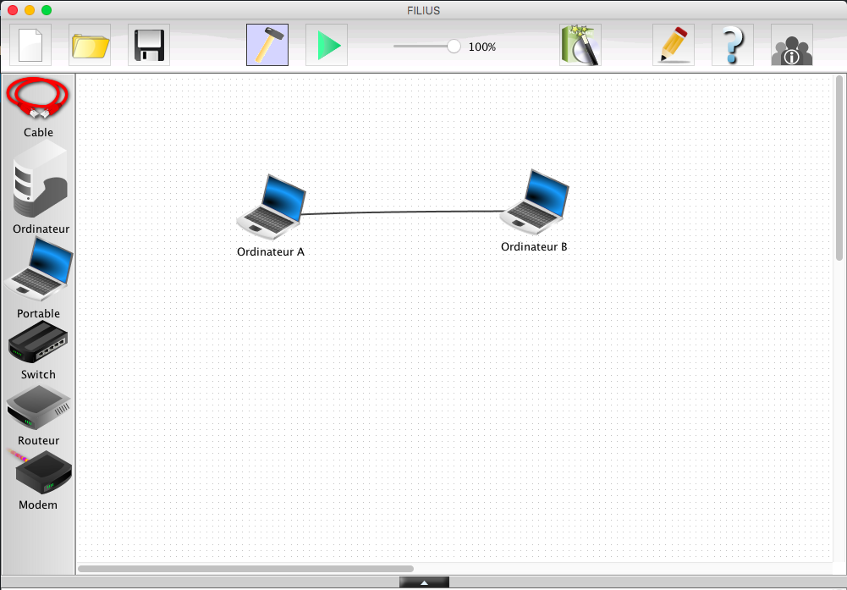
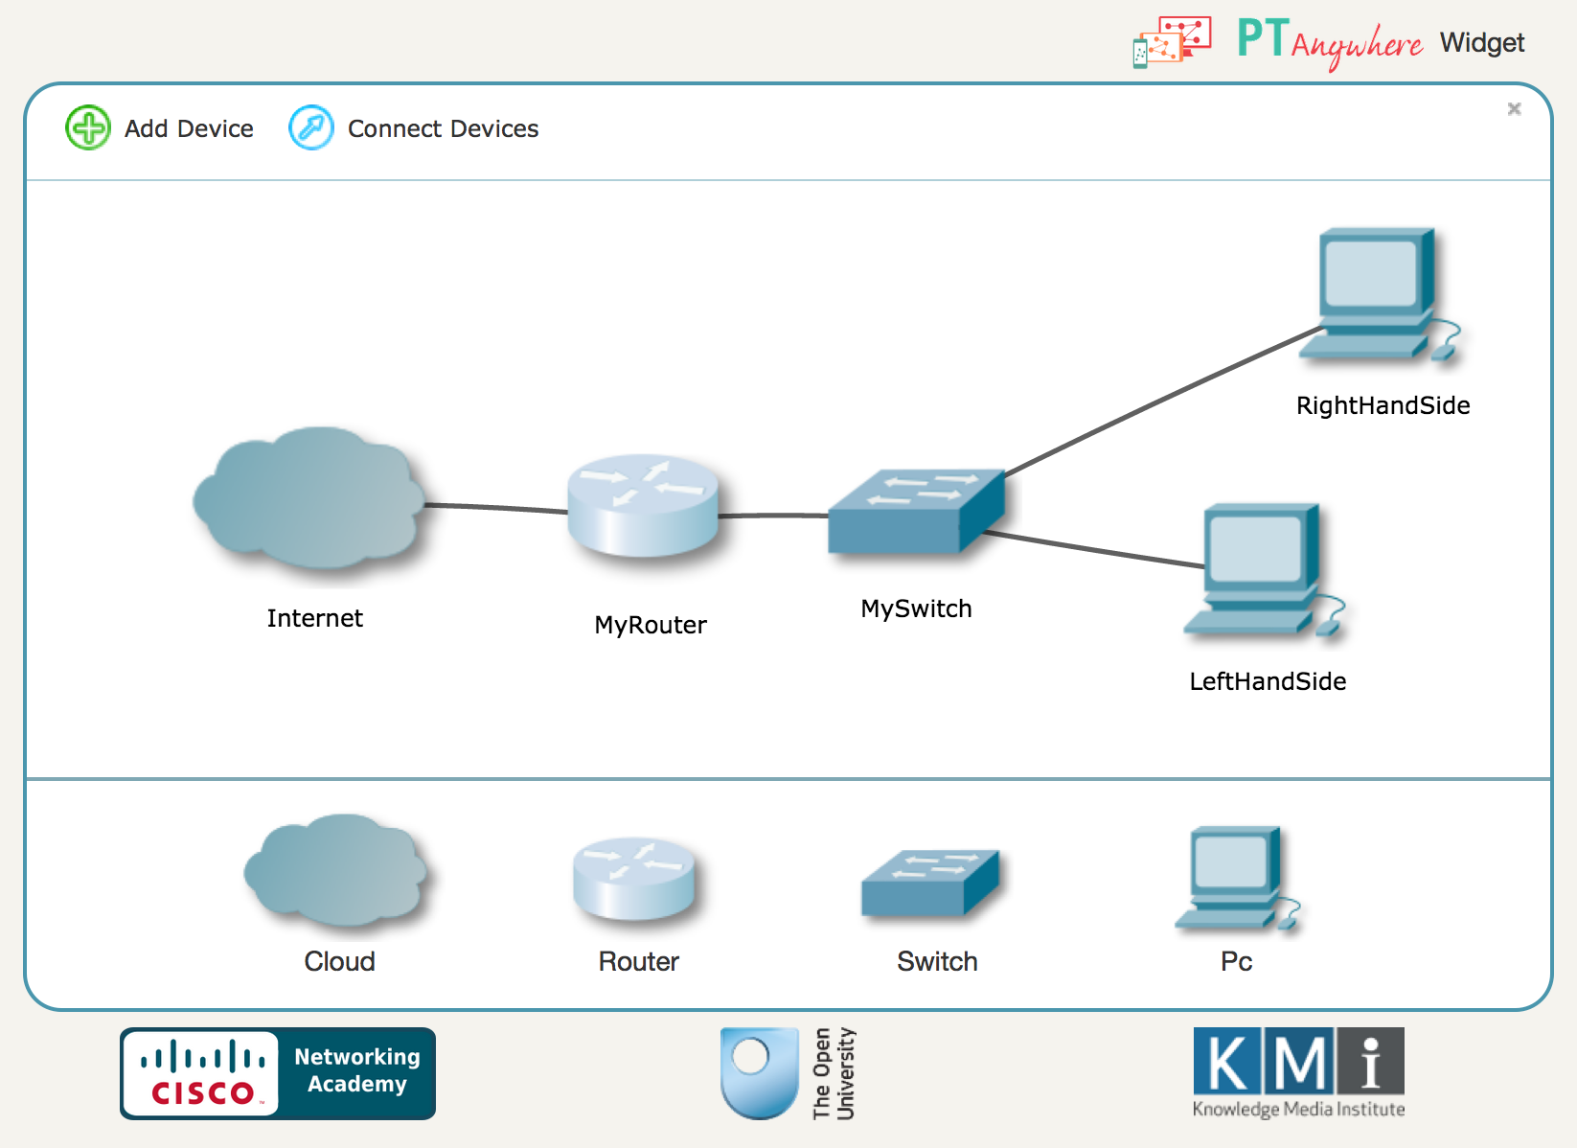
Context – QemuWeb
My Internship – develop a web version of QemuNet → allow students to use QemuNet from a simple browser…
Related Softwares
Filius Network Simulator (standalone software)
PT Anywhere (web app based on Cisco solution)

Slide 6


Architecture – Client-Server
client-side (frontend)
server-side (backend)
Handle multiple users (a single session by user)
Run a virtual network session (based on Qemunet)
Ensure the persistence of a session (e.g. network failure)
Preserve the integrity of the host machine (security issue)
Design a virtual network topology
Host & Switch settings
Display and interact with virtual machine via web terminals
Requirements: Performance (WebSocket), HTTPS, Authentication (OpenID), Security Issues, Deployment at CREMI, ..
Notes:
we need security and containment of sessions

Slide 7
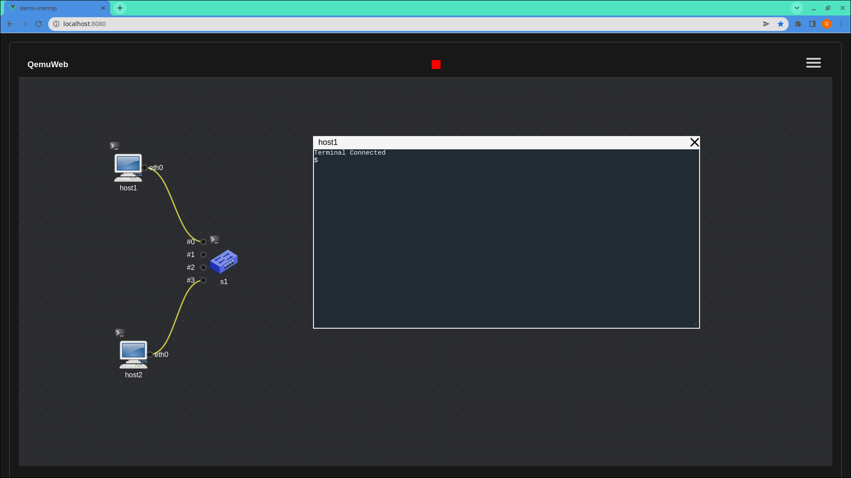








Architecture – Overview
Frontend
Backend
HTTPS
Web
App
$_
$_
Node.js Web Server
ptySpawn()
$_
$_
WebSocket

Slide 8
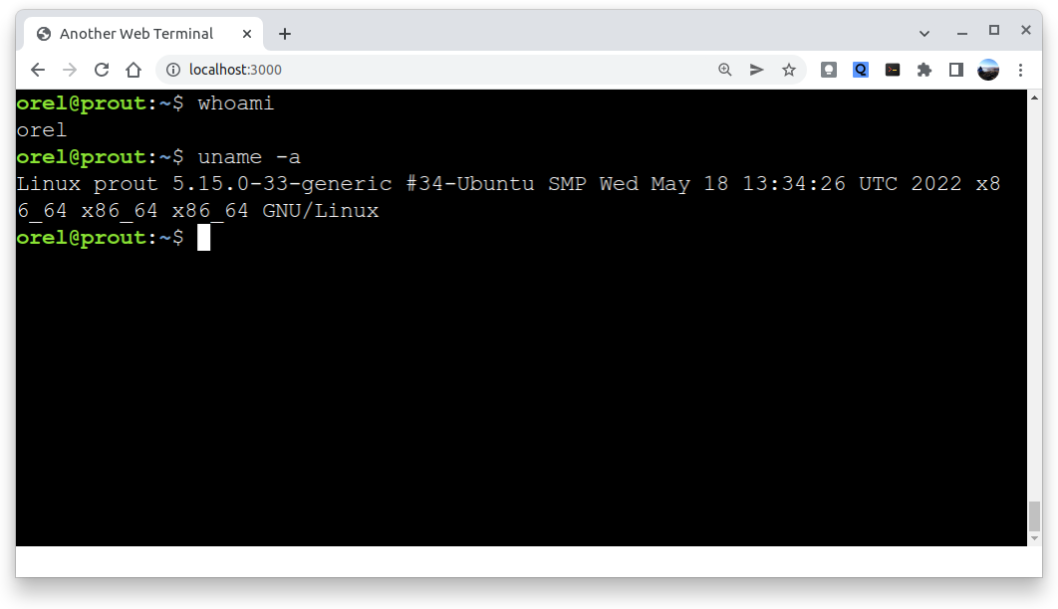
WebTerm – Proof-of-Concept for QemuWeb
Preliminary Project – just runs an interactive shell (on a remote server) and plays with it in your browser
Display and interact with multiple remote terminals (based on xterm.js) ✅
Performance achieved using WebSocket technology (socket.io) ✅
Ensure persistence of multiple sessions (tmux) 🔶
Security Issues: session containment in a harmless jail (firejail) ❌
Idea – deploy it on the web to help students to learn basic Linux commands at home (in a sandbox)

Slide 9
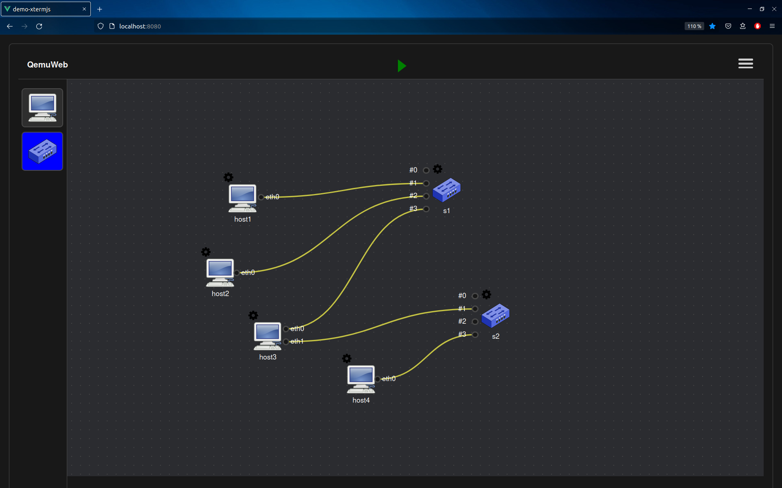
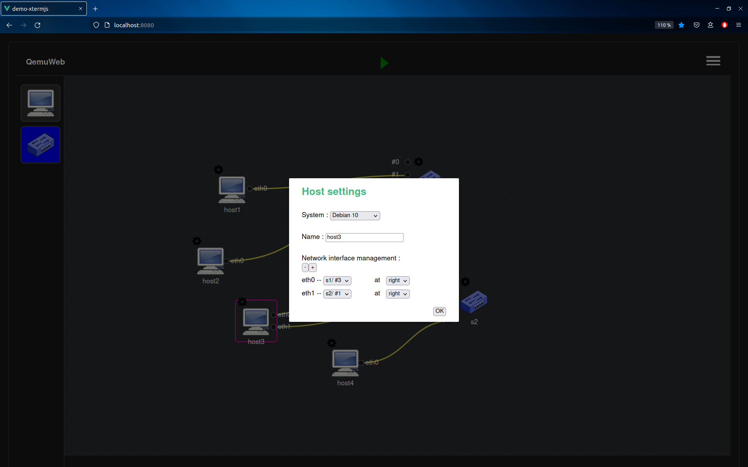
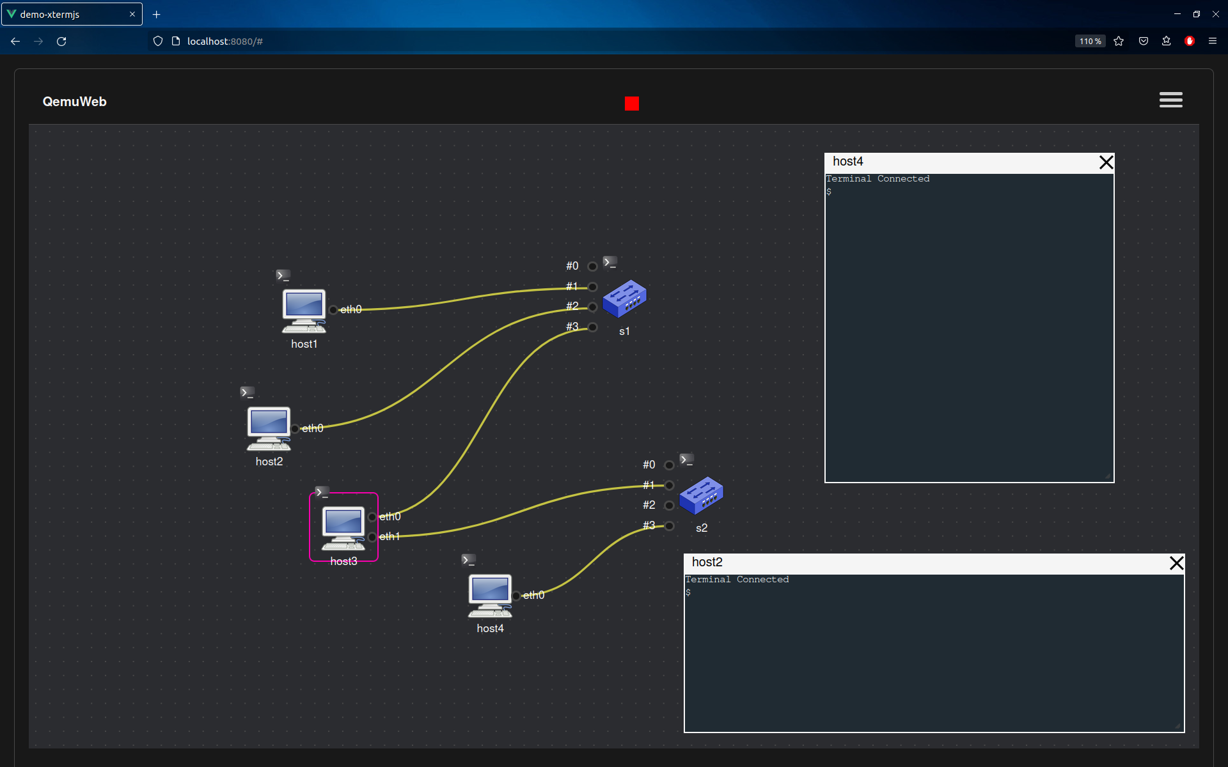
QemuWeb – Current Status
Design Mode
edit a virtual network topology → interconnect hosts and switches
host & switch settings (system, name, interfaces, …)
Execution Mode (true host & network emulation)
components terminal can be displayed
Terminals are movable and resizable

Slide 10
QemuWeb – To Do
Connect frontend xterm.js terminals with backend pty instances
Import/Export a topology file
Some issues to fix
Inputs/outputs do not center when changed sides
Curved connections do not connect correctly when the input is to the right of the switch
Hosts can have the same name (identification issue)

Slide 11
QemuWeb – Short Demo

Slide 12
Thank you for listening!

Slide 13
Appendix

Slide 14
Design Mode – create & modify virtual network topology

Slide 15
Design Mode – Host Settings

Slide 16
Execution Mode (Network Emulation)

Slide 17
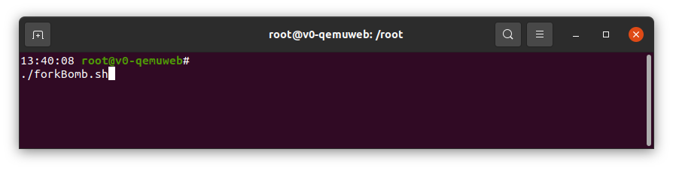

Security Issues
What if a remote client…
can run network commands on server machine?
can see and modify others files?
had root access to the server machine?
We have to confine users in separated jails and give them only a restricted environment

